Slide 1
Heroes of CSS
Day 3
April 2, 2016

Slide 2
Admin Work

Slide 3
Homework Assignment
Also, at this point everyone should have access to the class repository in GitHub. https://github.com/the-Coding-Boot-Camp-at-UT-Austin/04-16-Class-Content
Homework Assignment #1 is Due:
MW Class – Wednesday (4/27)
TTH Class – Thursday (4/28)

Slide 4
Homework Assignment
Really, work hard on this assignment! This assignment introduces you to fundamental concepts that we’ll be building the entire course-long.
Review In Class Material especially Exercises: https://github.com/the-Coding-Boot-Camp-at-UT-Austin/04-16-Class-Content
Work with your peers! It’s much better than screaming at your computer alone.
Ask Questions on Slack! Your peers, TAs, and Instructors are all here to help when they can.

Slide 5
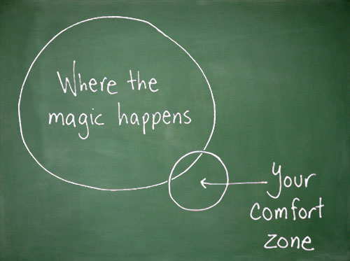
Most Important of All….
Just Submit SOMETHING… Even if it seems pretty crummy!

Slide 6
Warning!

Slide 7

Brace Yourselves
Today is going to be a bit tough.
But trust us!
It will all look easy a few weeks from now.
Notes:
Today is going to be tough. Its not tough conceptually, it’s tough because it is new.

Slide 8
Brace Yourselves
Don’t expect to understand EVERYTHING at once.
Today is all about getting immersed
Notes:
The idea is to expose yourself to as much as possible, and take in as much as possible. Then when you are working on your homework you can immerse yourself by making sure to push yourself on the homework. Its like a CSS buffet, Fill your plate, then take it back to your table and feast!

Slide 9
CSS Recap

Slide 10
Critical Question
What is “CSS”?

Slide 11


HTML / CSS Definitions (*yawn* unimportant)
HTML: Hypertext Markup Language – (Content)
CSS: Cascading Style Sheets – (Appearance)
HTML/CSS are the “languages of the web”. Together they define both the content and the aesthetics of a webpage – handling everything from the layouts, colors, fonts, and content placement. (Javascript is the third – handling logic, animation, etc.)

Slide 12


HTML / CSS Analogy
HTML Alone
Like writing papers in “Notepad”.
Can only write unformatted text.
HTML / CSS
Like writing papers in Microsoft Word.
Can format text, page settings, alignment, etc. based on “highlighting” and menu options.
Notes:
So notepad is the basic content and nothing else, and word is that same content but now we add style to it like border, font-families and color. The same content is still there looking pretty but it could easily be copied back down to notepade and still be “readable”.

Slide 13

Basic HTML Page - Result

Slide 14

Enter CSS - Result

Slide 15
Critical Question
How do we style HTML…
Elements? – just html tags - 1
Classes? - .className, reusable - 10
IDs? – #idName, use once - 100
Notes:
Three most common ways of styling html, directly putting element, class can be used over and over again and ID’s should only be used once per page. Never start a classname or id with a number or special character (and please don’t use uppercase letters, that’s just wrong). One more new thing to introduce here is specificity, or which css rule wins. Each element is a wrester in the competition and gets a score based on their selector, or how specific it is. Elements are worth 1, classes are worth 10 and ID’s are worth, the more heavy hitters on your side the better chance you win, or are the most specific , more here: https://css-tricks.com/specifics-on-css-specificity/

Slide 16

CSS Syntax
CSS works by hooking onto selectors added into HTML using “classes and identifiers”.
Classes use .classname, IDs #Idname, and elements their name
Once hooked, we apply styles to those HTML elements using css .
Notes:
After briefly showing this slide, switch to my HTML and CSS next to each other for the last exercise. Discuss the file.

Slide 17
Lingering Questions
Questions so far?
Notes:
Make sure to queue the TA that will be entering the questions. Take each question in slack and post it to the class to explain to their peers. Other TA’s listen in and offer corrections as needed. Then discuss quickly after. Move on to another question.

Slide 18
Relative File Paths

Slide 19
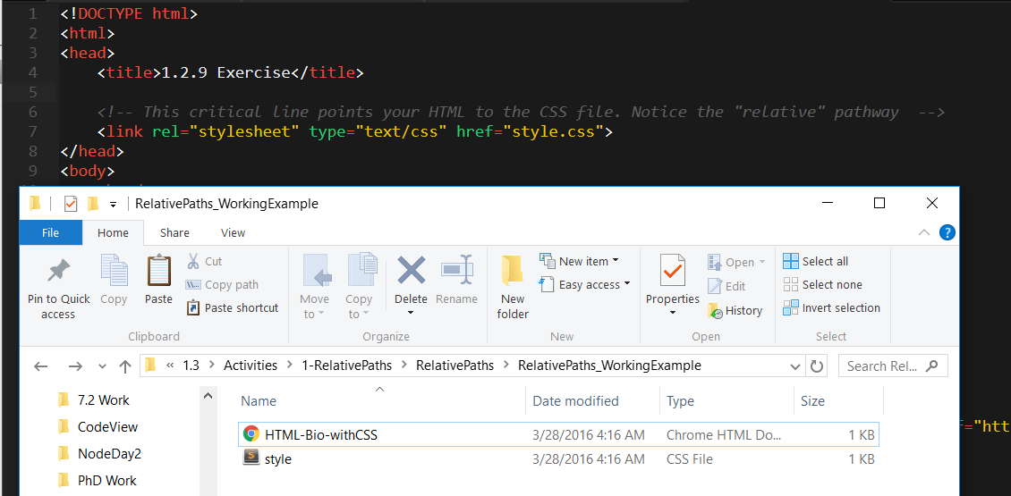
Relative File Paths
Relative file paths allow us to access other files (like CSS or image files) relative to the file we are looking at.
Notes:
We have been referencing external css files. The most important thing to know is where the current location is - The file you/user are viewing (usually index.htm). We have already been working with this in the command line.

Slide 20
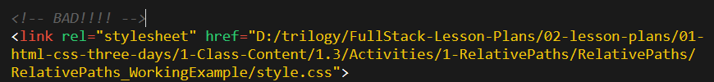

Absolutely No Absolute Paths
VERY VERY BAD
ALWAYS USE RELATIVE FILE PATHS.
Otherwise, when moving your web page or deploying your site – all of your links will fail to load correctly.
Remember there is no such thing as a “C:” drive on the internet.
Notes:
But unlike the terminal never have an absolute path to a harddrive location. There are some exceptions, but the will always be an with an absolute “url”, that starts with http:// ,but hopefully none of you will get jobs building html emails.

Slide 21
Quick Demo
Instructor: Demo
(RelativePaths_DEMO | 1-RelativePaths)
Notes:
[ctrl+shift+p] duplicate - Lets take a look at relative paths in action. (OPEN DEMO IN BROWSER, then move the css to a folder, update the url to reflect.

Slide 22
> YOUR TURN!!
Activity: 1-RelativePaths| Suggested Time: 10 min
Assignment
Unzip the folder sent to you via slack.
Then edit the HTML files inside of each “RelativePaths” folder such that each HTML file can access the CSS file using relative paths.
An example is given to you in the “RelativePaths_WorkingExample” folder.
Notes:
Extract the zip to your harddrive and modify each of the four bio pages to display correctly. DO not move the files, just modify the paths to the css.
Once the class is done demo each.

Slide 23
Box Model

Slide 24
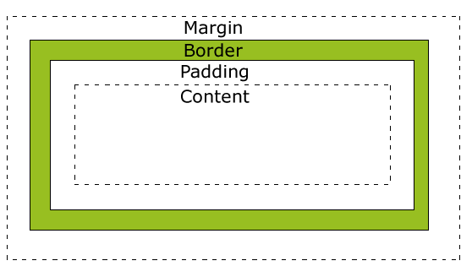
Boxes Upon Boxes
In CSS, every element can be considered to fit within a series of boxes. Each box can be individually adjusted to provide spacing between elements or to fill in elements with colors.
Styles can applied as follows: 20px 10px 10px 20px (top, right, bottom, left)
Notes:
Everything in the land of the internet is a box (even if the content is irregular shaped it is contained in a box, little boxes trying to fit together, little boxes on the hillside. Made with ticky-tacky, or html and css. In the box model each element can have have padding, border and margin. I like to think of it like a house. The content is your house, the padding is your yard (its your property but its not really house, just space around your house), the border is the fence, it marks the end of our property. The margin is like an easement, nothing can exist inside the easement until it ends. That end could but up against another properties easement or their fence, yard or even right to their house. If all values are zero…. Appartments! Each piece of content has its own size, but the full width and height of an element can be more than the content, if there is padding or border, the actual width or height will be the content plus these values. Similar the margin adds extra size to the full footprint of the “property”.

Slide 25
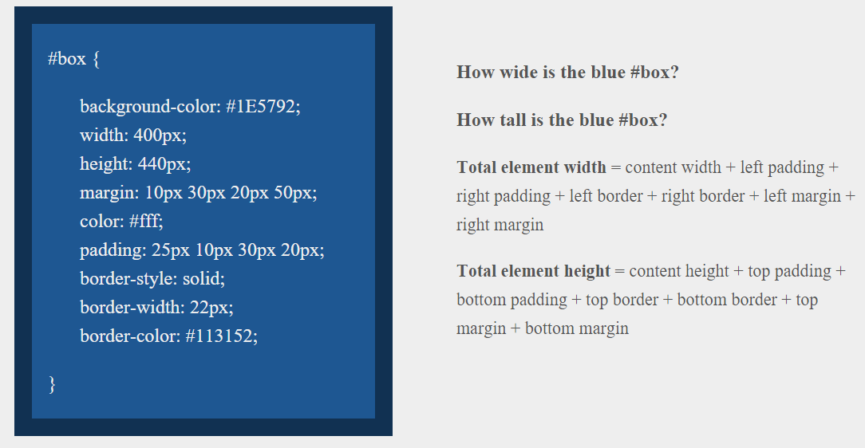
> YOUR TURN!!
Suggested Time: 10 min

Slide 26
> YOUR TURN!!
Answer
Width: 474 px (no margin), 554 px (with margin)
Height: 539 px (no margin), 569 px (with margin)

Slide 27
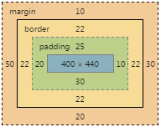
> YOUR TURN!!
Answer
Width: 474 px (no margin), 554 px (with margin)
Height: 539 px (no margin), 569 px (with margin)
Notes:
http://guyroutledge.github.io/box-model/

Slide 28
We Be Floatin’

Slide 29

Take a Facebook Break…
Warning!
These next topics are fairly “tricky”… but VERY IMPORTANT.
Time to channel that inner genius.

Slide 30

The Concept of “Flow”
In HTML/CSS, (by default) every element displayed is governed by a concept called “flow”.
This means that HTML elements force their adjacent elements to flow around them.
Notes:
The concept of flow controls all our little boxes, the css display property controls this behavior and the two most common display options are inline and block.

Slide 31
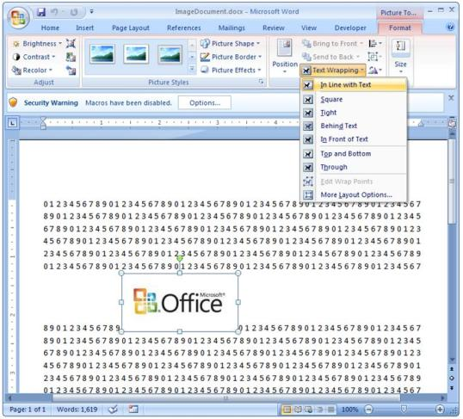
Flow Analogy to MS Word
This concept of “flow” is very similar to the wrap-text options you may be familiar with in Microsoft Word.
Just as in MS Word, you can have images in-line with text, on-top of text, etc.
Notes:
Cover text in slide, THEN: as they said, these images are inline with their sourounding text, that means the baseline of the image is the same as the text, other stuff attempts to flow around and wrap.

Slide 32
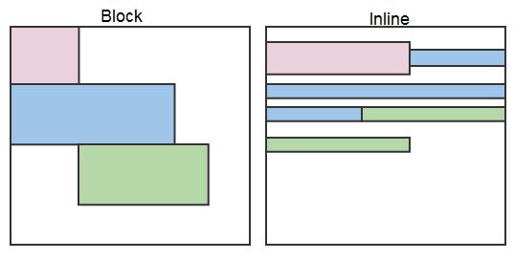
Block Elements
By default, many HTML elements (paragraphs, headers, div, etc..) are treated as block elements.
This means, they take up an entire line of space, unless you intervene with CSS properties.
Notes:
However most tags are block display by defaut, you can change it using the display property. Block level items occupy their entire width available.

Slide 33
Block Elements vs. Inline Elements
Now… contrast the block elements with inline elements.
By using float CSS properties, we can command our website to display multiple CSS elements adjacently.
Notes:
What would happen to the inline version if the viewport (or the screen) got wider? With float we can break the flow.

Slide 34
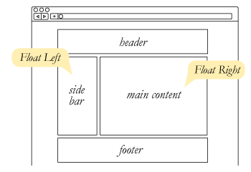
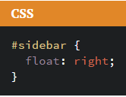
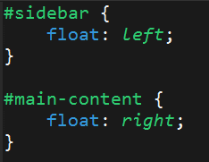
Floating
In order make these block elements behave similar to inline elements, we utilize a CSS property called float.
Floats are necessary for building web layouts
Notes:
By applying float we force content to float upward and to the right or left.

Slide 35
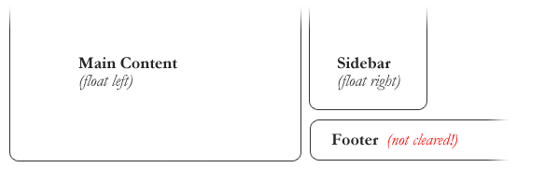
Clearing the Float
Sometimes… floats get in the way, and elements that we don’t want to be “in-line” are treated as such.
Notes:
If there is available space above a floated element it will “rise” up and can cause some VERY unintended consequences.

Slide 36
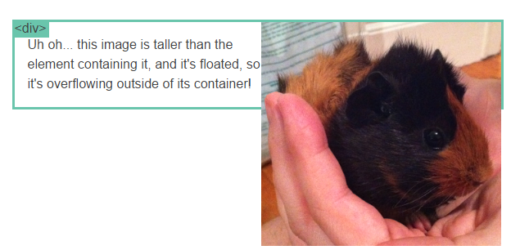
Clearfix Hack
Sometimes when elements don’t match up in size, we get situations like the above…
Notes:
Floated elements no longer obey the flow and can overflow and overlap other pieces of content.

Slide 37
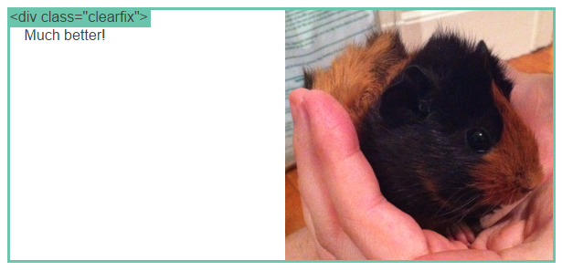
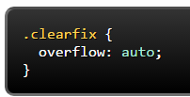
Clearfix Hack
We can get around it by using what’s called the “clearfix hack”. By using the CSS property overflow: auto, the first element will fill up the empty parts of the flow.
Notes:
By using proper clearfixing methods we can re-establish the flow when we need it and then add more floated elements below.

Slide 38

Quick Demo!
Notes:
Most websites start out their lives as wireframes, and it is often our jobs as developers to be able to slice those wireframes into html chunks that we give correct flow and sizing with css. Ask the class to shout out percentages on the wireframe.

Slide 39
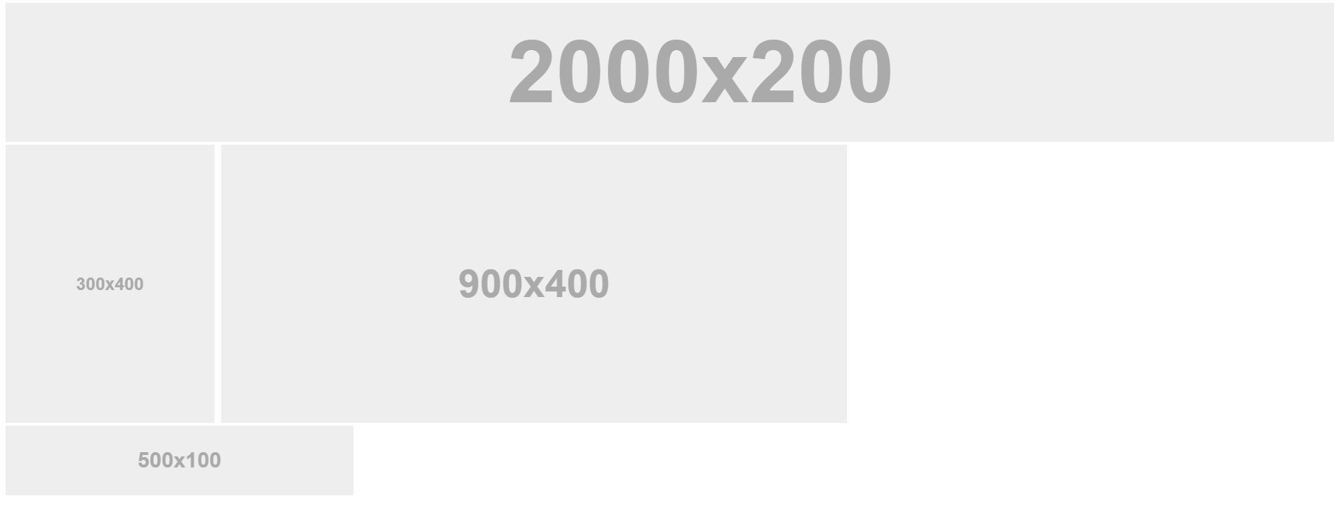
Quick Demo!
Notes:
Here is a simple example of the wireframe using images.

Slide 40
Quick Demo
Instructor: Demo
(2-FloatExamples)
Notes:
CTRL+SHIFT+p dupe open the non-float, talk, open the style, talk, open the floated one with its

Slide 41

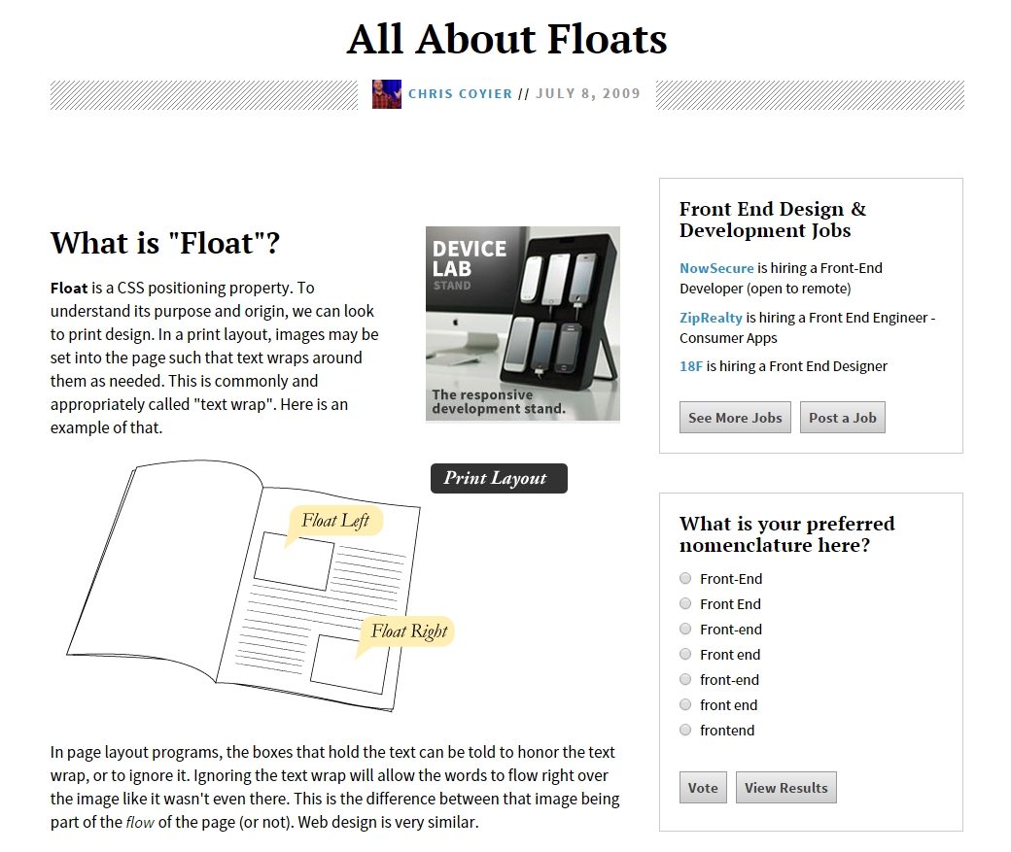
Fantastic Guide on Floats ****
To all serious front-end developers (this is a necessary read): https://css-tricks.com/all-about-floats/

Slide 42
> YOUR TURN!!
Activity: 3-FloatLayout-Activity | Suggested Time: 30 min
Assignment
In this activity, you will be flexing your newfound floating skills to create a conceptual layout. Eyeball the design to your best ability.
Additional instructions, sent via Slack.

Slide 43
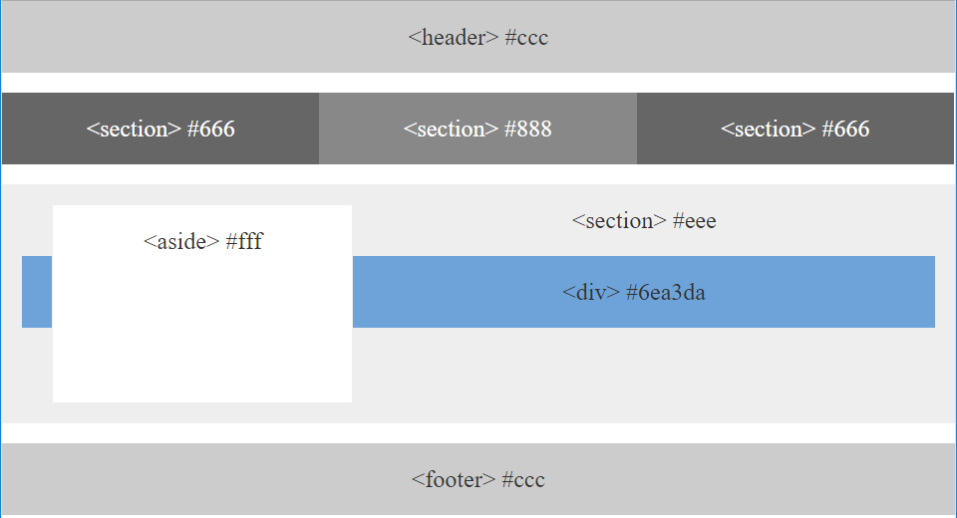
> YOUR TURN!!
Notes:
Discuss instructions

Slide 44

Good work!
Your Brain may rest now
Notes:
Review project

Slide 45
BREAK!

Slide 46
CSS Positioning

Slide 47
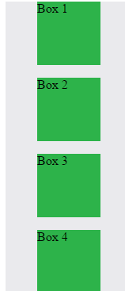
Position: Static (Default)
Four boxes placed statically (default)
Notes:
Positioning default is static or in its normal flow.

Slide 48
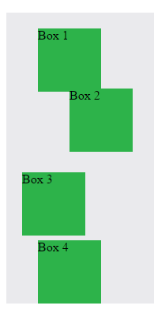

Position: Relative
Switching the boxes to relative nudges the boxes in relation to their “original” location.
Notes:
If we set the positioning to relative we can offset or element from its normal positon in flow.

Slide 49
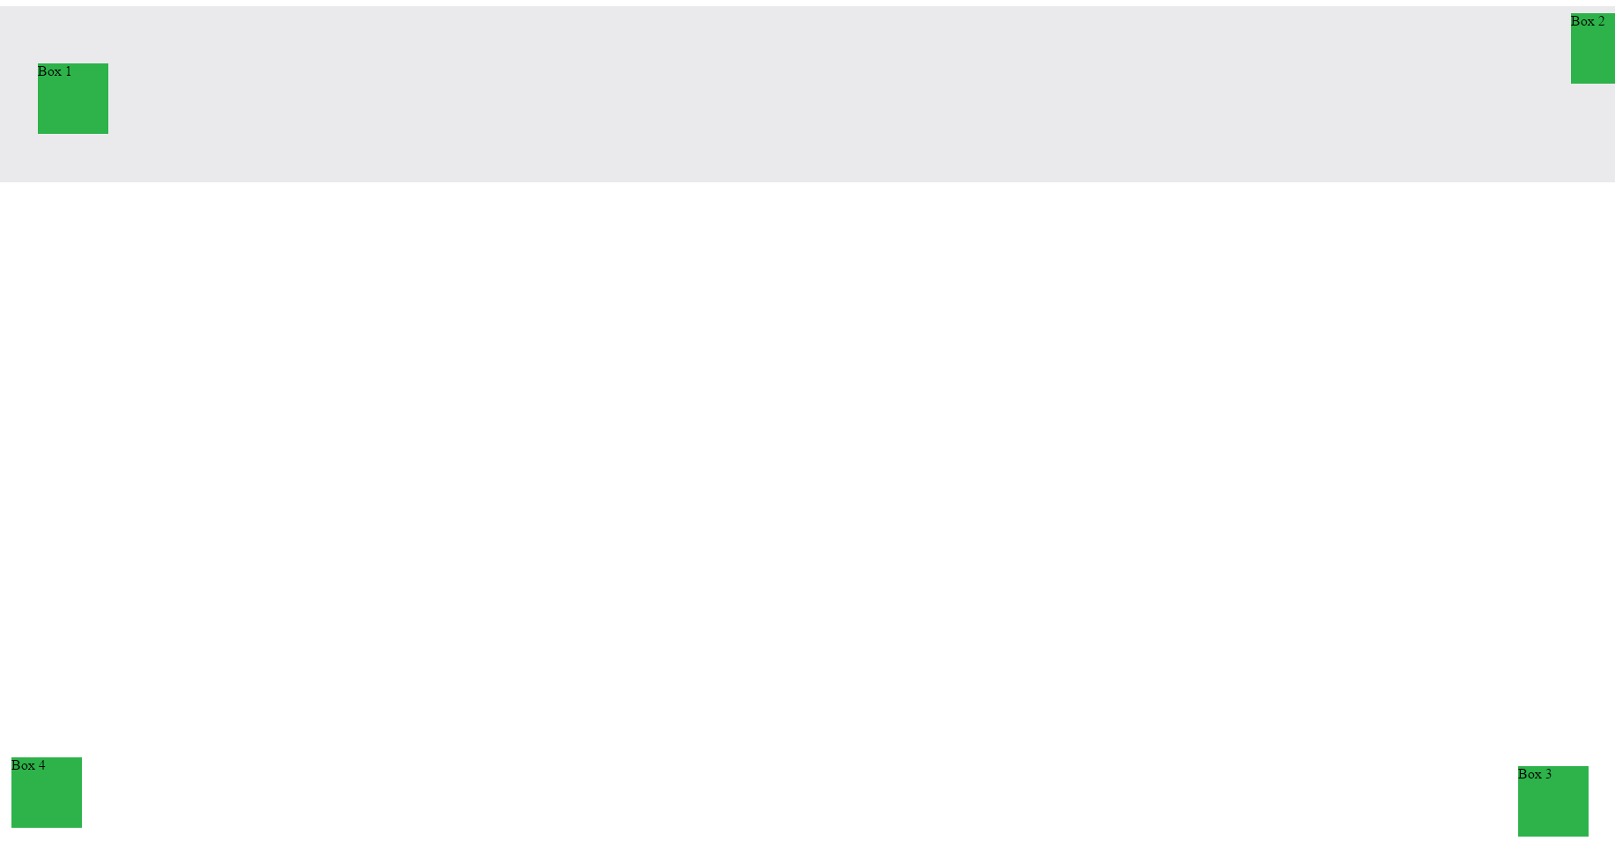
Position: Absolute
Position with location relevant to first “placed” element
Notes:
Absolute positions moves the element in position with its first parent that also has positioning, or if no parent existing, it positions based on the entire page.

Slide 50

Position: Fixed
Position with exact coordinates to the browser window
Notes:
Fixed removes the element from the flow and fixes it to a location on the viewport(browser window)

Slide 51
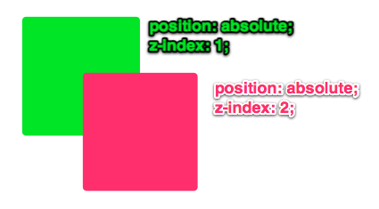
Layering with Z-Index
Z-Index allows you to layer elements on top of each other when placed in absolute coordinates
Notes:
Elements with positioning can sometimes overlap. Any element with positioning can be given z-index, meaning its heights above others.

Slide 52
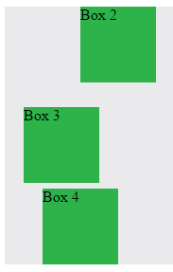
Hiding Things
Display none allows elements to be completely hidden from view.
This becomes useful because in later sections, we will be selectively activating and de-activating.
Notes:
We discussed the display property earlier in relation to Block VS Inline but there is another commonly used display, of none, this removes the element completely from the page, including any space it was occupying.

Slide 53
Quick Demo
Instructor: Demo
(5-CSS_PositionedLayout)
Notes:
Open the series, in browser, then comment and apply diff css, open in browser and show difference then talk about that css file

Slide 54
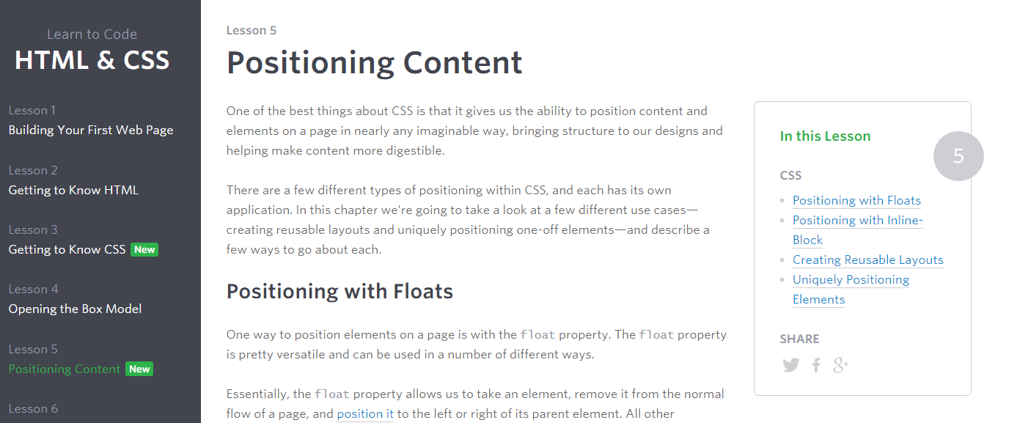
Great Resource
Another great read for front-end developers (and game designers): http://learn.shayhowe.com/html-css/positioning-content/

Slide 55
> YOUR TURN!!
6-CSS_Positioned_Activity | Suggested Time: 30 min
Assignment
In this activity, you will be flexing your newfound positioning skills to create another conceptual layout. Eyeball the design to your best ability.
Additional instructions, sent via Slack.

Slide 56

> YOUR TURN!!
Notes:
Discuss instructions, review the solution when the exercise is over

Slide 57
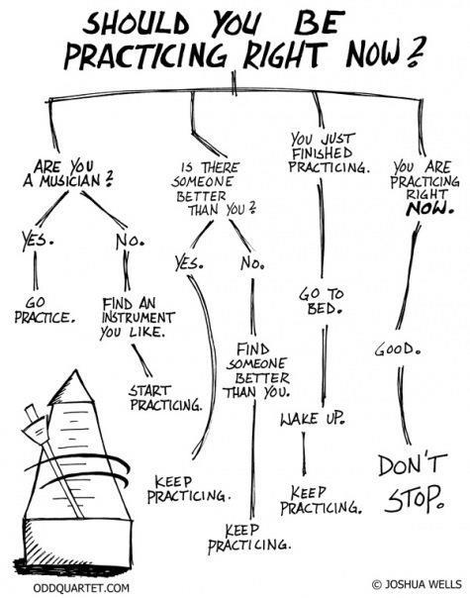
Advice
Re-do this at home. It’s a good one to firm up your HTML/CSS skills.
REMEMBER:
The best way to get good is to PRACTICE

Slide 58
Chrome Inspector

Slide 59
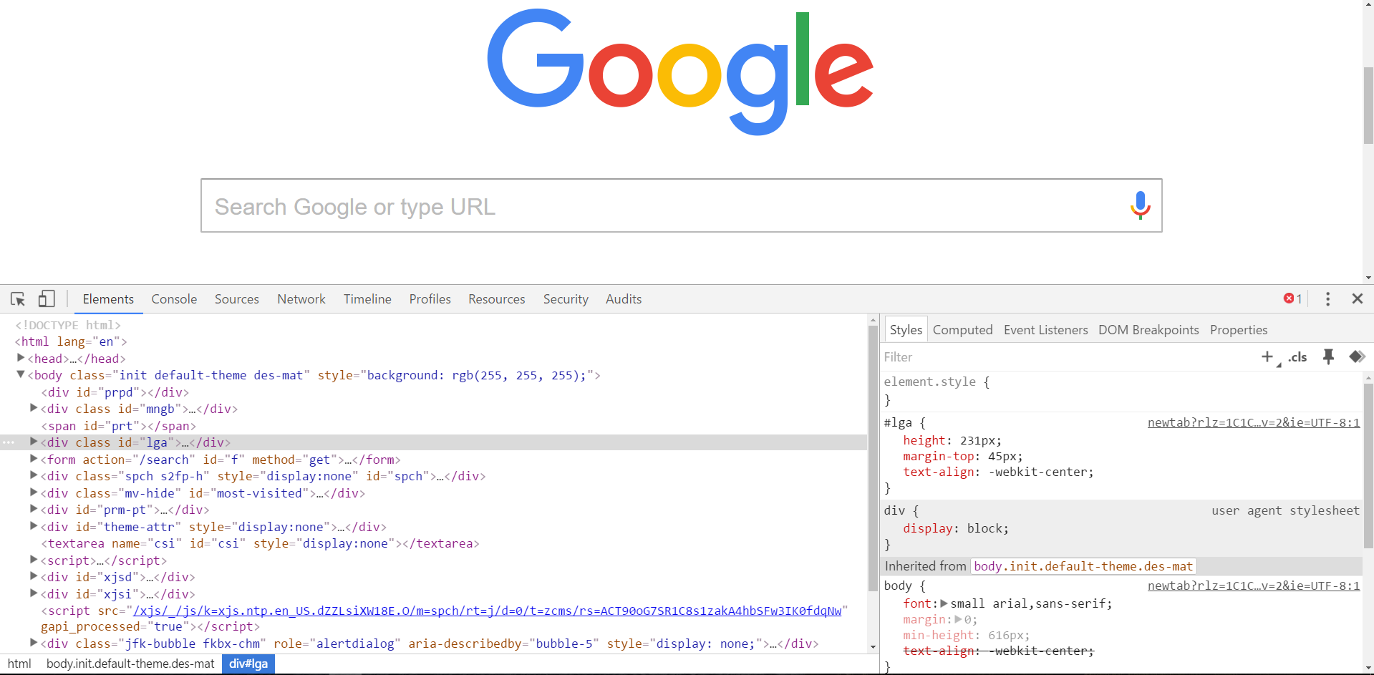
Chrome Inspector is Your Friend
To access chrome inspector: Right click on a page then hit “Inspect”
It will allow you to inspect the HTML, CSS, and more!

Slide 60

Chrome Inspector is Your Friend
Using Chrome Inspector you can readily edit any webpage (your own or otherwise) to see the immediate impact of HTML or CSS changes

Slide 61
Next Class!
We’ll be coming back to this next class ☺
Notes:
And over and over

Slide 62
Recap + Reassurances

Slide 63


Slide 64
Questions?

Slide 65
EXTRA MATERIAL

Slide 66
> YOUR TURN!!
Assignment
For the next 15 minutes, take a website that you commonly use (Amazon, Google, Huff Po, etc.) and heavily modify it using the Google Developer Tools.
Be sure to at least modify:
Content (Change words)
Colors
Spacing
Etc.
Send a screenshot to the class’ slack profile when you’re done.

Slide 67
CSS Resets

Slide 68

Loading Multiple CSS Files ***(Very Important!!!)***
One of the most powerful aspects of CSS is the ability to deploy multiple CSS files simultaneously.
This allows developers the ability to create complex designs – made up of multiple design elements.
Just remember the loading order matters!!!

Slide 69
What Browser?
By a show of hands…
Which browser do you use?

Slide 70

Battle of the Browsers
Under-the hood there are often significant differences between how browsers render webpages.
These differences in rendering agents can mean HTML/CSS gets displayed differently in each.
As designers/developers, creating cross-browser compatible websites is critical.

Slide 71

Reset.css (or Normalize.css)
Reset.css ensures that all browser-specific css has been reset, so it appears the same in all browsers.
This means you will have to re-style everything yourself

Slide 72
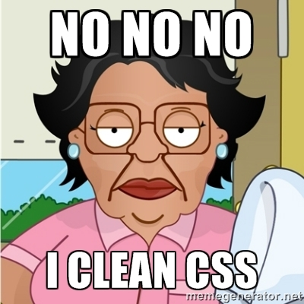
Why CSS Resets Matter
It’s important for creating browser-compatible websites
It’s an example of using someone else’s CSS in your website!!!
It’s a common Front-End Developer Interview question.

Slide 73
> YOUR TURN!!
Assignment
Follow the instructions given via slack to incorporate a reset.css file into a basic HTML file.
Note the impact the reset file makes after its inclusion.

